Slide 1






Introducing Debugging
Unveiling the Power of Code Inspection
MIB’s Research Club | May 23rd, 2024

Slide 2
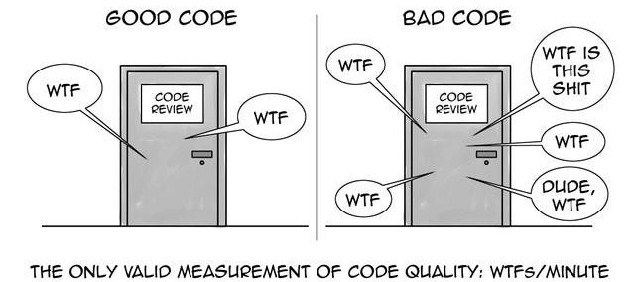
Background | Debugging | Types of errors | Debugging techniques | Hands-on examples
clean code
Code that is easy to read, understand and maintain.
WHAT
IS
THIS
WHAT
WHAT
WHAT
WHAT
WHAT
WHAT
WHATs / MINUTE
https://miro.medium.com/v2/resize:fit:640/1*h4_BugUpRdyoLbRfeHGS7Q.jpeg

Slide 3
Background | Debugging | Types of errors | Debugging techniques | Hands-on examples
Good coding practices
Meaningful variable and function names
Consistent formatting and style
Commenting and documentation
Modular design
Regular Refactoring
Writing tests

Slide 4
Background | Debugging | Types of errors | Debugging techniques | Hands-on examples
Importance of clean code
Prevents bugs
Eases Maintenance
Fosters Collaborations
↑ Efficiency

Slide 5

Background | Debugging | Types of errors | Debugging techniques | Hands-on examples
Prevents bugs
What is Debugging?
The process of finding and correcting errors/unexpected behaviour in your code.

Slide 6
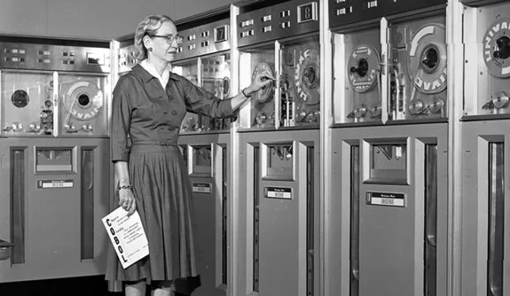
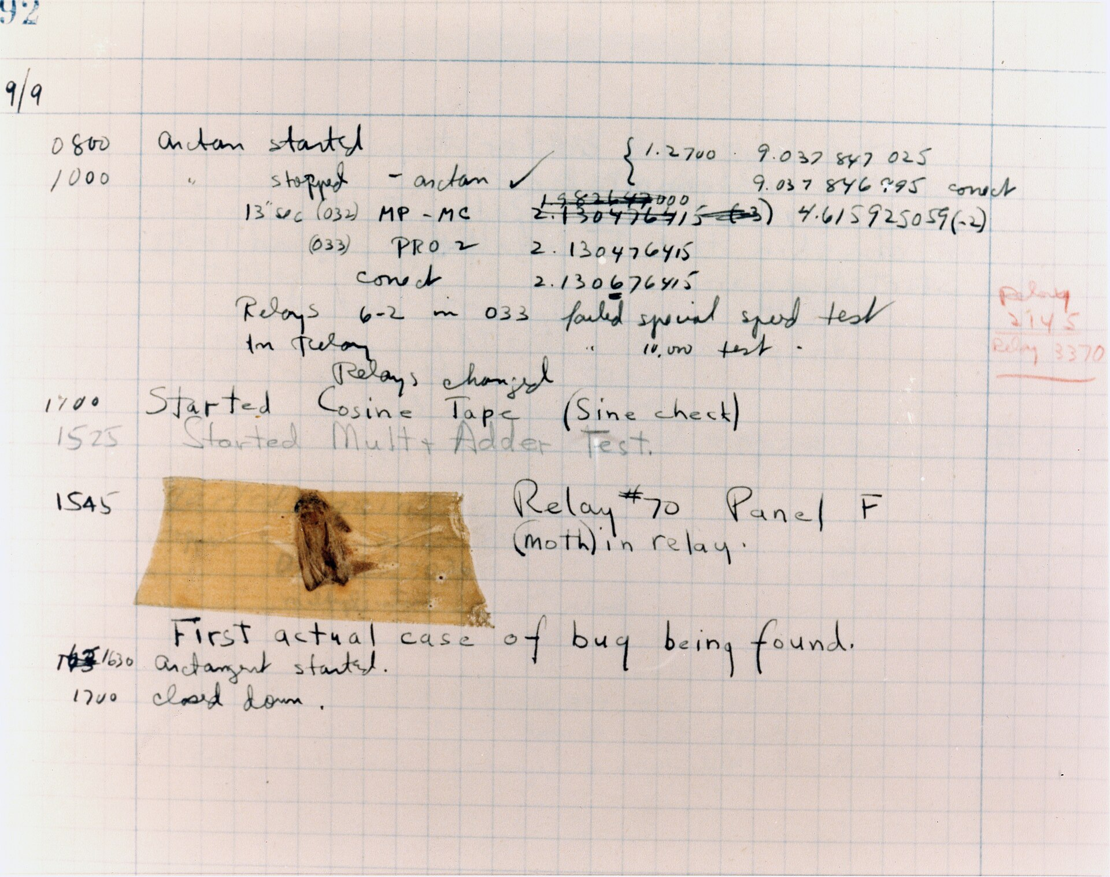
Background | Debugging | Types of errors | Debugging techniques | Hands-on examples
Why is it called “Debugging”?

Slide 7
Background | Debugging | Types of errors | Debugging techniques | Hands-on examples
Why is it useful?
Code reliability
Saves time
Learning
Code quality

Slide 8
Background | Debugging | Types of errors | Debugging techniques | Hands-on examples
tyPES OF ERRORS
Syntax errors
print("Coding is fun!
Logical errors
def is_positive(number): if number > 1: return True
Runtime errors
numbers = [1 , 2 , 3] print(numbers [3])
Semantic errors
def square_that_num(num_arg): squared_num = num_arg ** 2 return squared_num num_arg= “10”
Environment errors file_path = "/path/to/nonexistent/file.txt" if os.path.exists(file_path): with open(file_path, "r") as file: content = file.read()

Slide 9


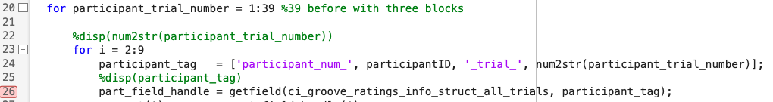
Background | Debugging | Types of errors | Debugging techniques | Hands-on examples
Debugging techniques
Peer reviews
Print statements
(Conditional) Breakpoints
Rubber duck

Slide 10


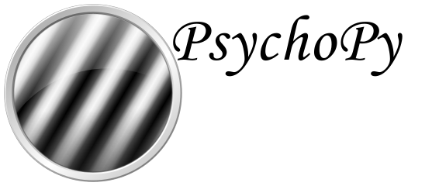





Background | Debugging | Types of errors | Debugging techniques | Hands-on examples
Case 1
Case 3
Error in loop displaying fixation cross.
Index exceeds the number of array elements.
Case 2
Case 4
Error in mathematical operation and saving file.
Error in trigger being sent with wrong number.
Case 5
Incorrect usage of logical operators and indexes out of range.

Slide 11


Extra Resources
Python
MATLAB
clean-code-python
Debugging in MATLAB
clean-code-ml
JupyterLab
General
Visual debugger
Summary of ‘Clean Code’ by Robert C. Martin
More debugging
R
This is my “thank you for your attention” dance!
Debugging in RStudio

